Slide 1
Digital Frameworks
Lesson 1
Medill on the Hill
Sean McMinn
github.com/shmcminn/digitalframeworks-spring19

Slide 2
Intros
Hi there! I’m Sean McMinn. When I’m not standing up here, I’m busy at NPR, where I make graphics and write stories based on *~data~*

Slide 3
Digital Frameworks?
Yep, it’s vague
Notes:
We’re going to focus primarily on using data to tell a story. We’ll also work a bit on digital presentation, mostly of data stories.

Slide 4
When we think about data...
Notes:
When you think about data and data journalism, what kinds of stories do you think about?

Slide 5
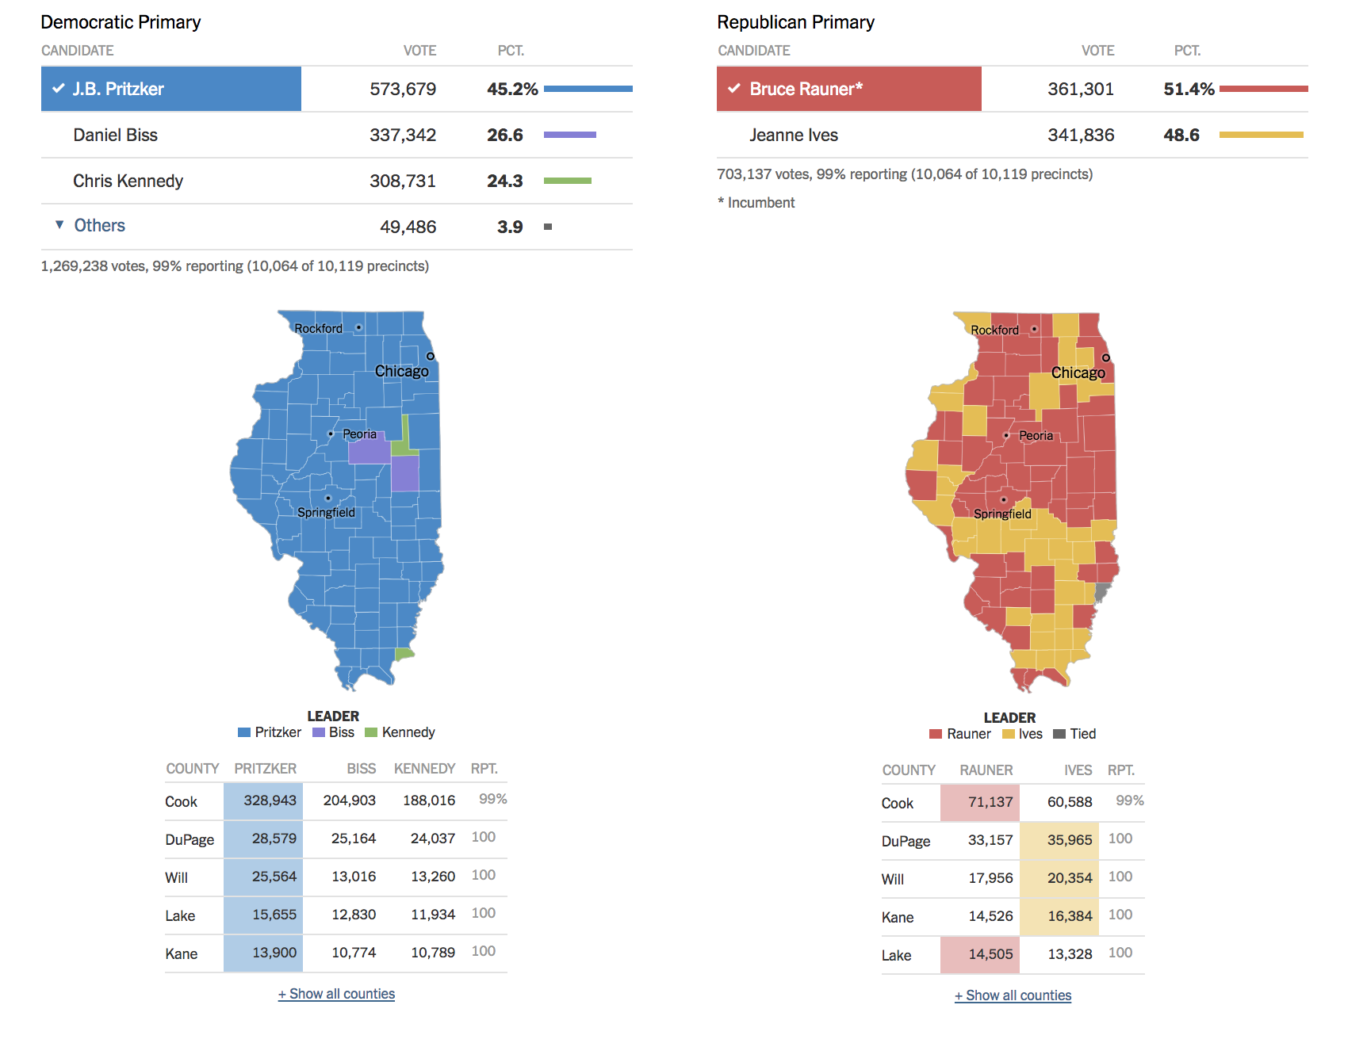

Slide 6
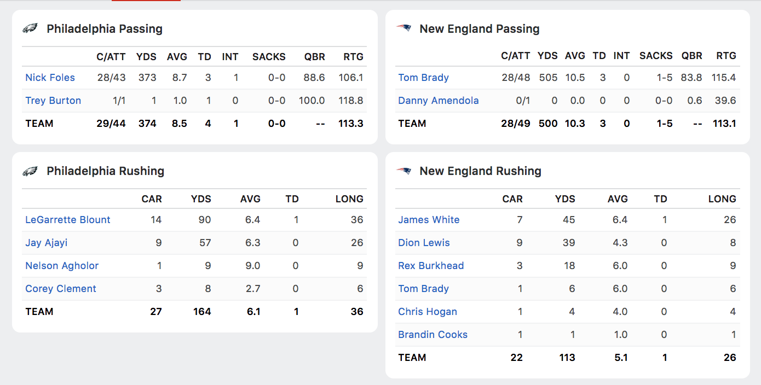

Slide 7
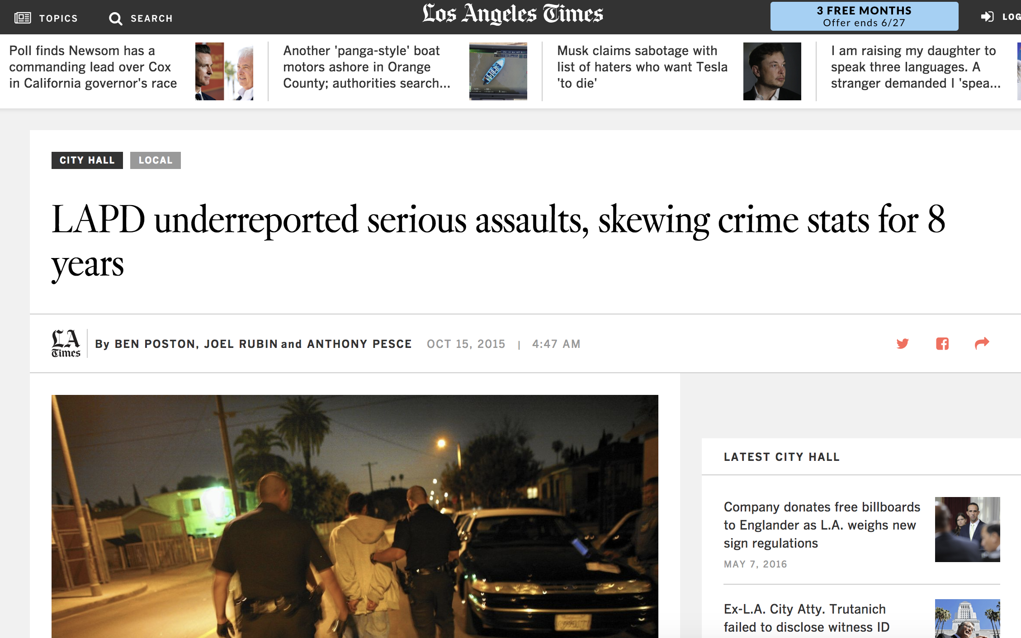

Slide 8
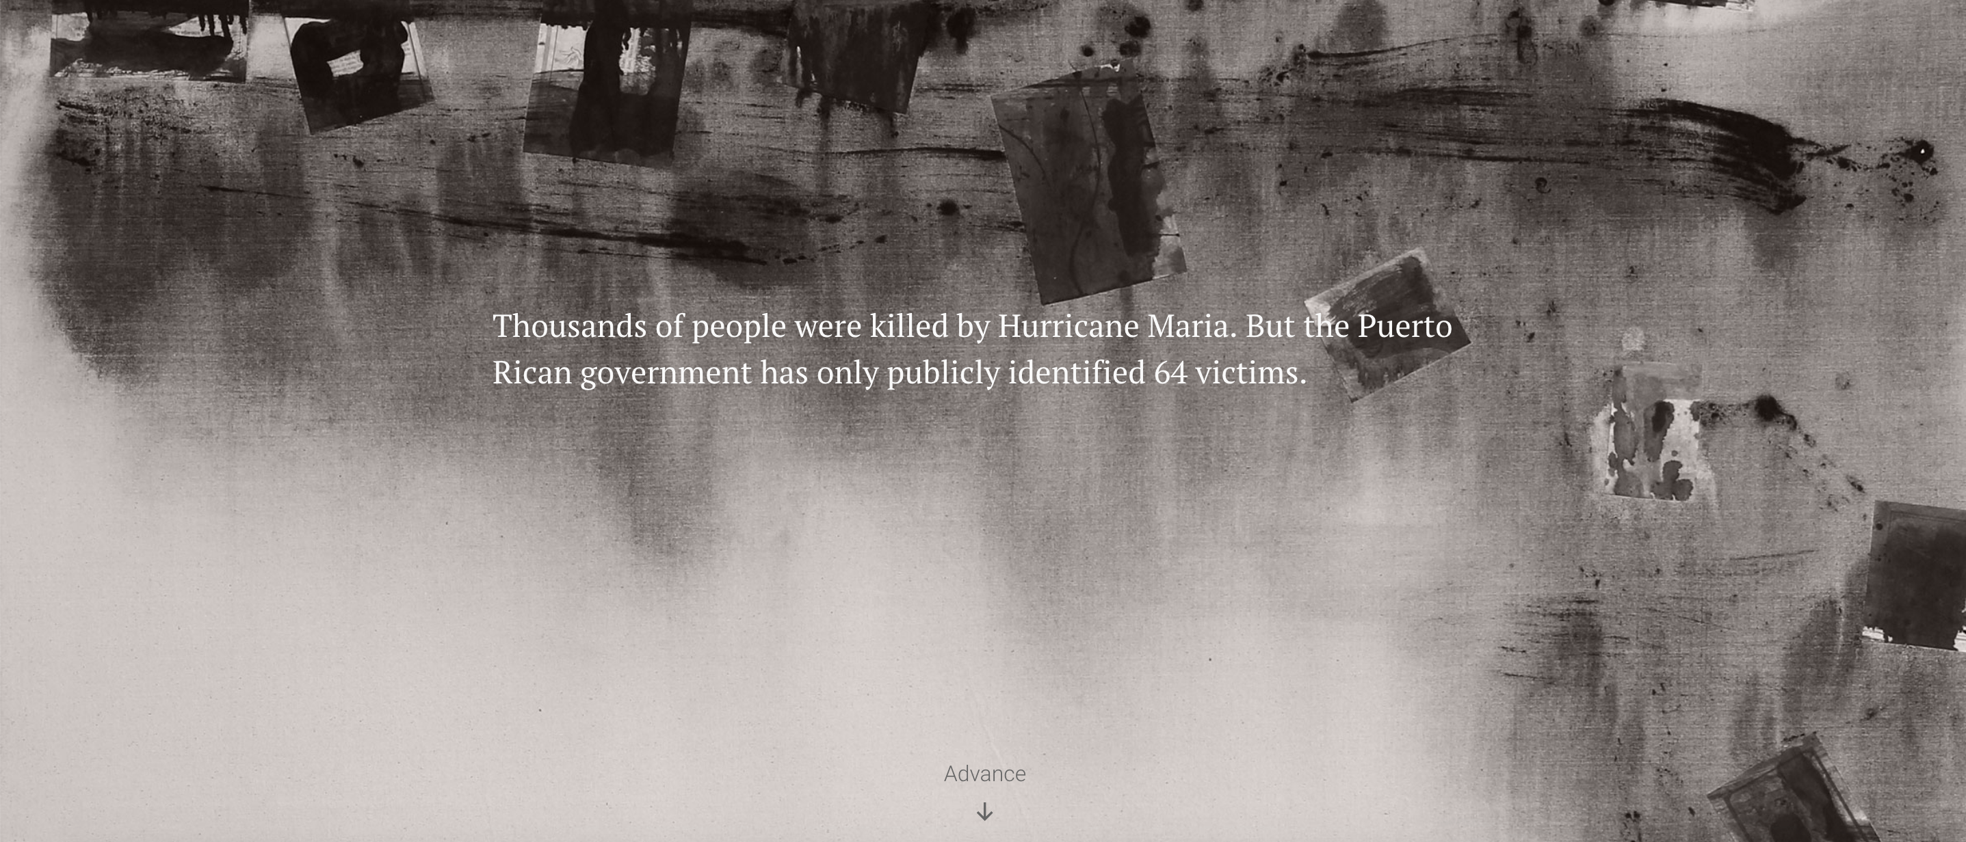

Slide 9
...but many non-data stories are actually data stories

Slide 10

Notes:
This is what happens when you put programmers in your newsroom and give them a little flexibility.

Slide 11
Once upon a time...
...a reporter was
on a tight deadline
(!)
Notes:
Shocker, I know. So this reporter had a list of House members, and they wanted to see how each of their fundraising was going compared to their opponents.

Slide 12
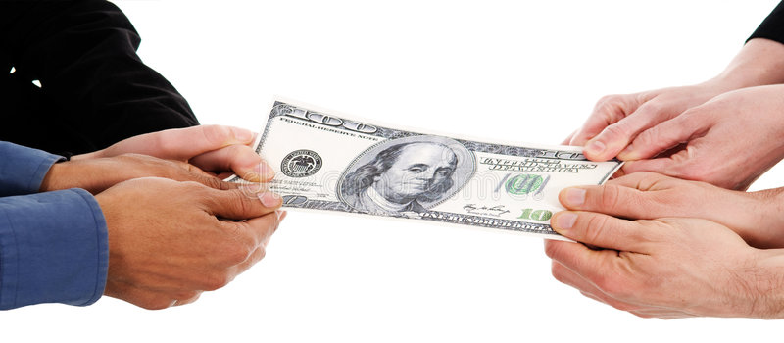
Notes:
Shocker, I know. So this reporter had a list of House members, and they wanted to see how each of their fundraising was going compared to their opponents. MONEY FIGHT!

Slide 13
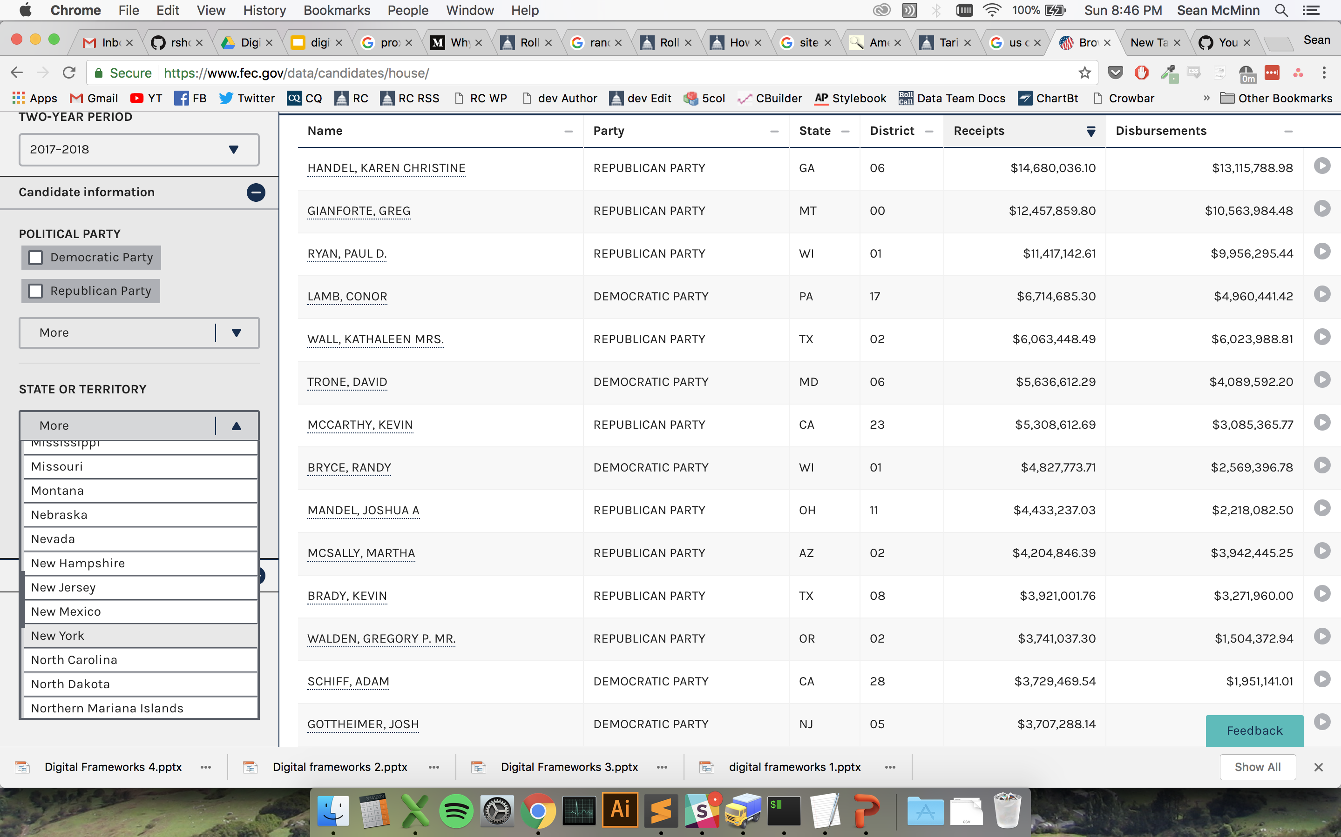
Notes:
They could have used this fun FEC interface, where you go and click a drop down for the state, and then another one for the district. And then they would have had to download a separate spreadsheet for each race.

Slide 14

Notes:
But who has time for that on deadline? This reporter could have just written a story based on old data, which was already analyzed by a think tank, and called it a day. But he called in our the nerds — our data editor and me — and what do you know …

Slide 15
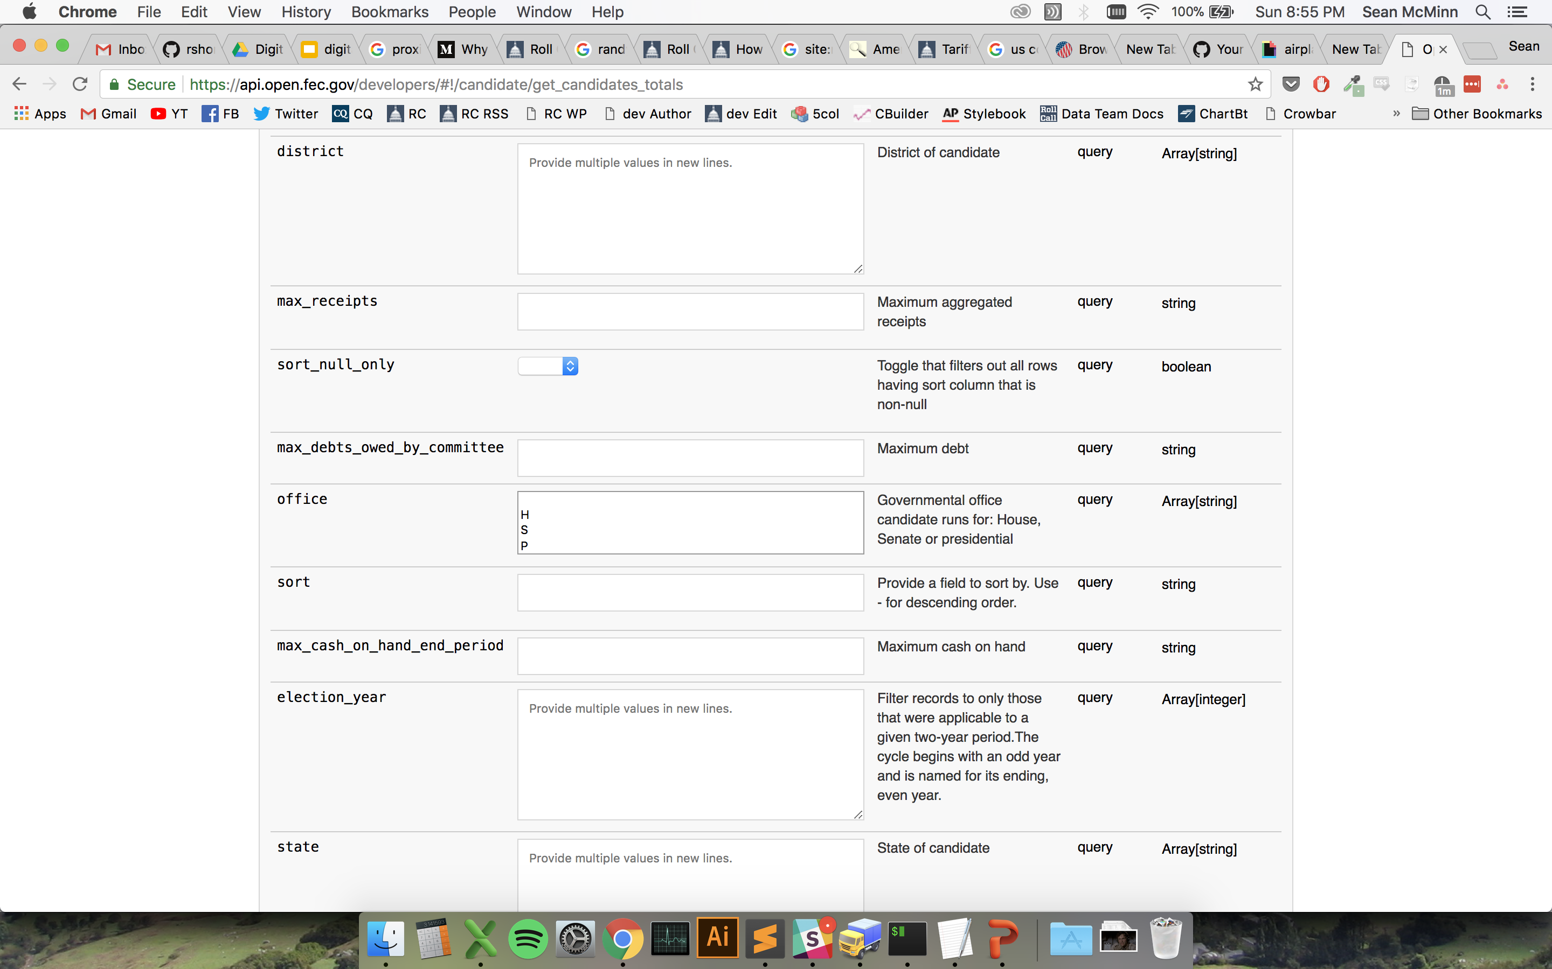
Notes:
There was a better way! The FEC has a whole interface just for programmers to go and get it’s data, and it’s super straightforward.

Slide 16
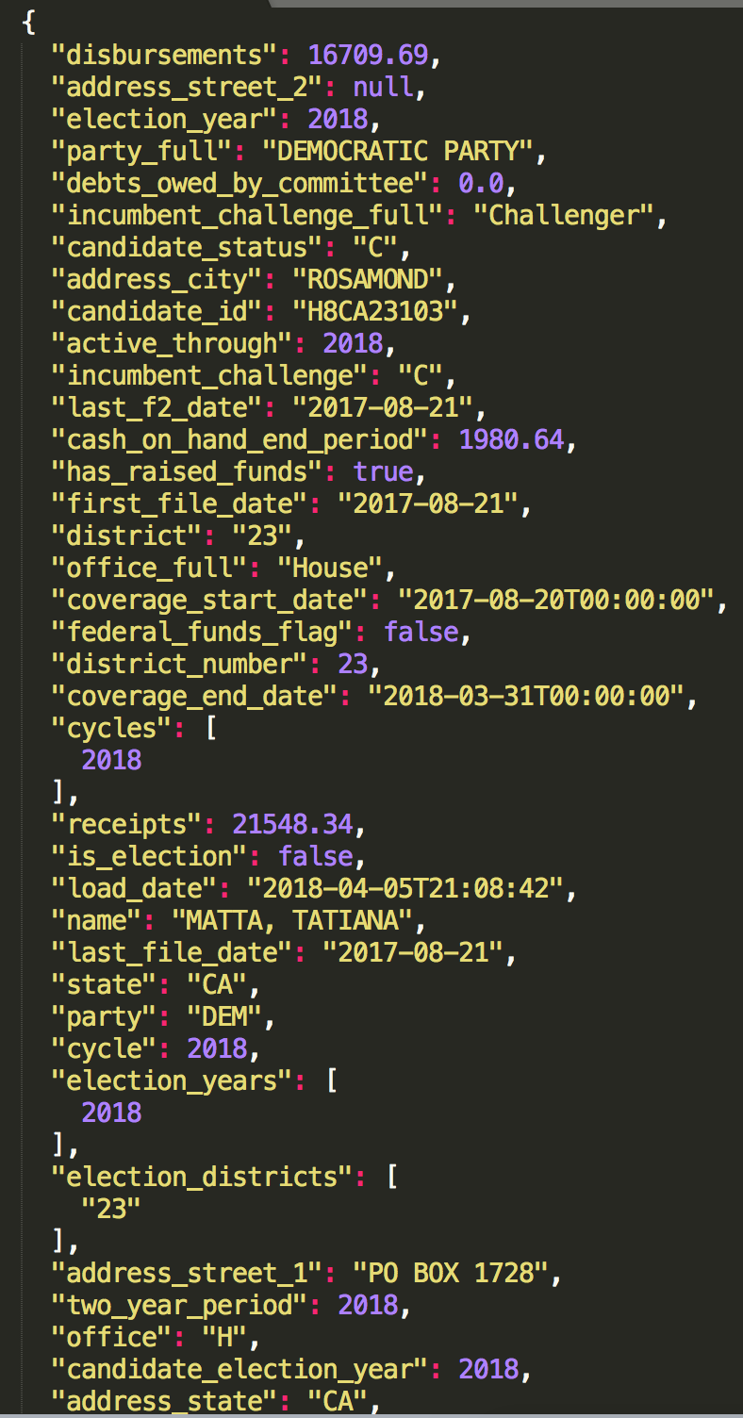
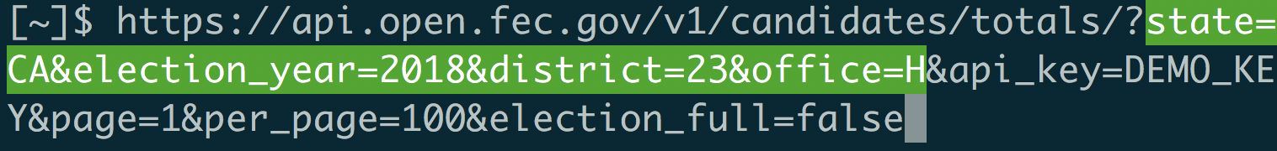
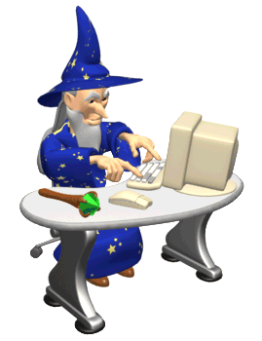
Notes:
You just go to a url that asks for the data you want, and like magic, it’s there.

Slide 17
API
Notes:
Not wizardry – application programming interface

Slide 18
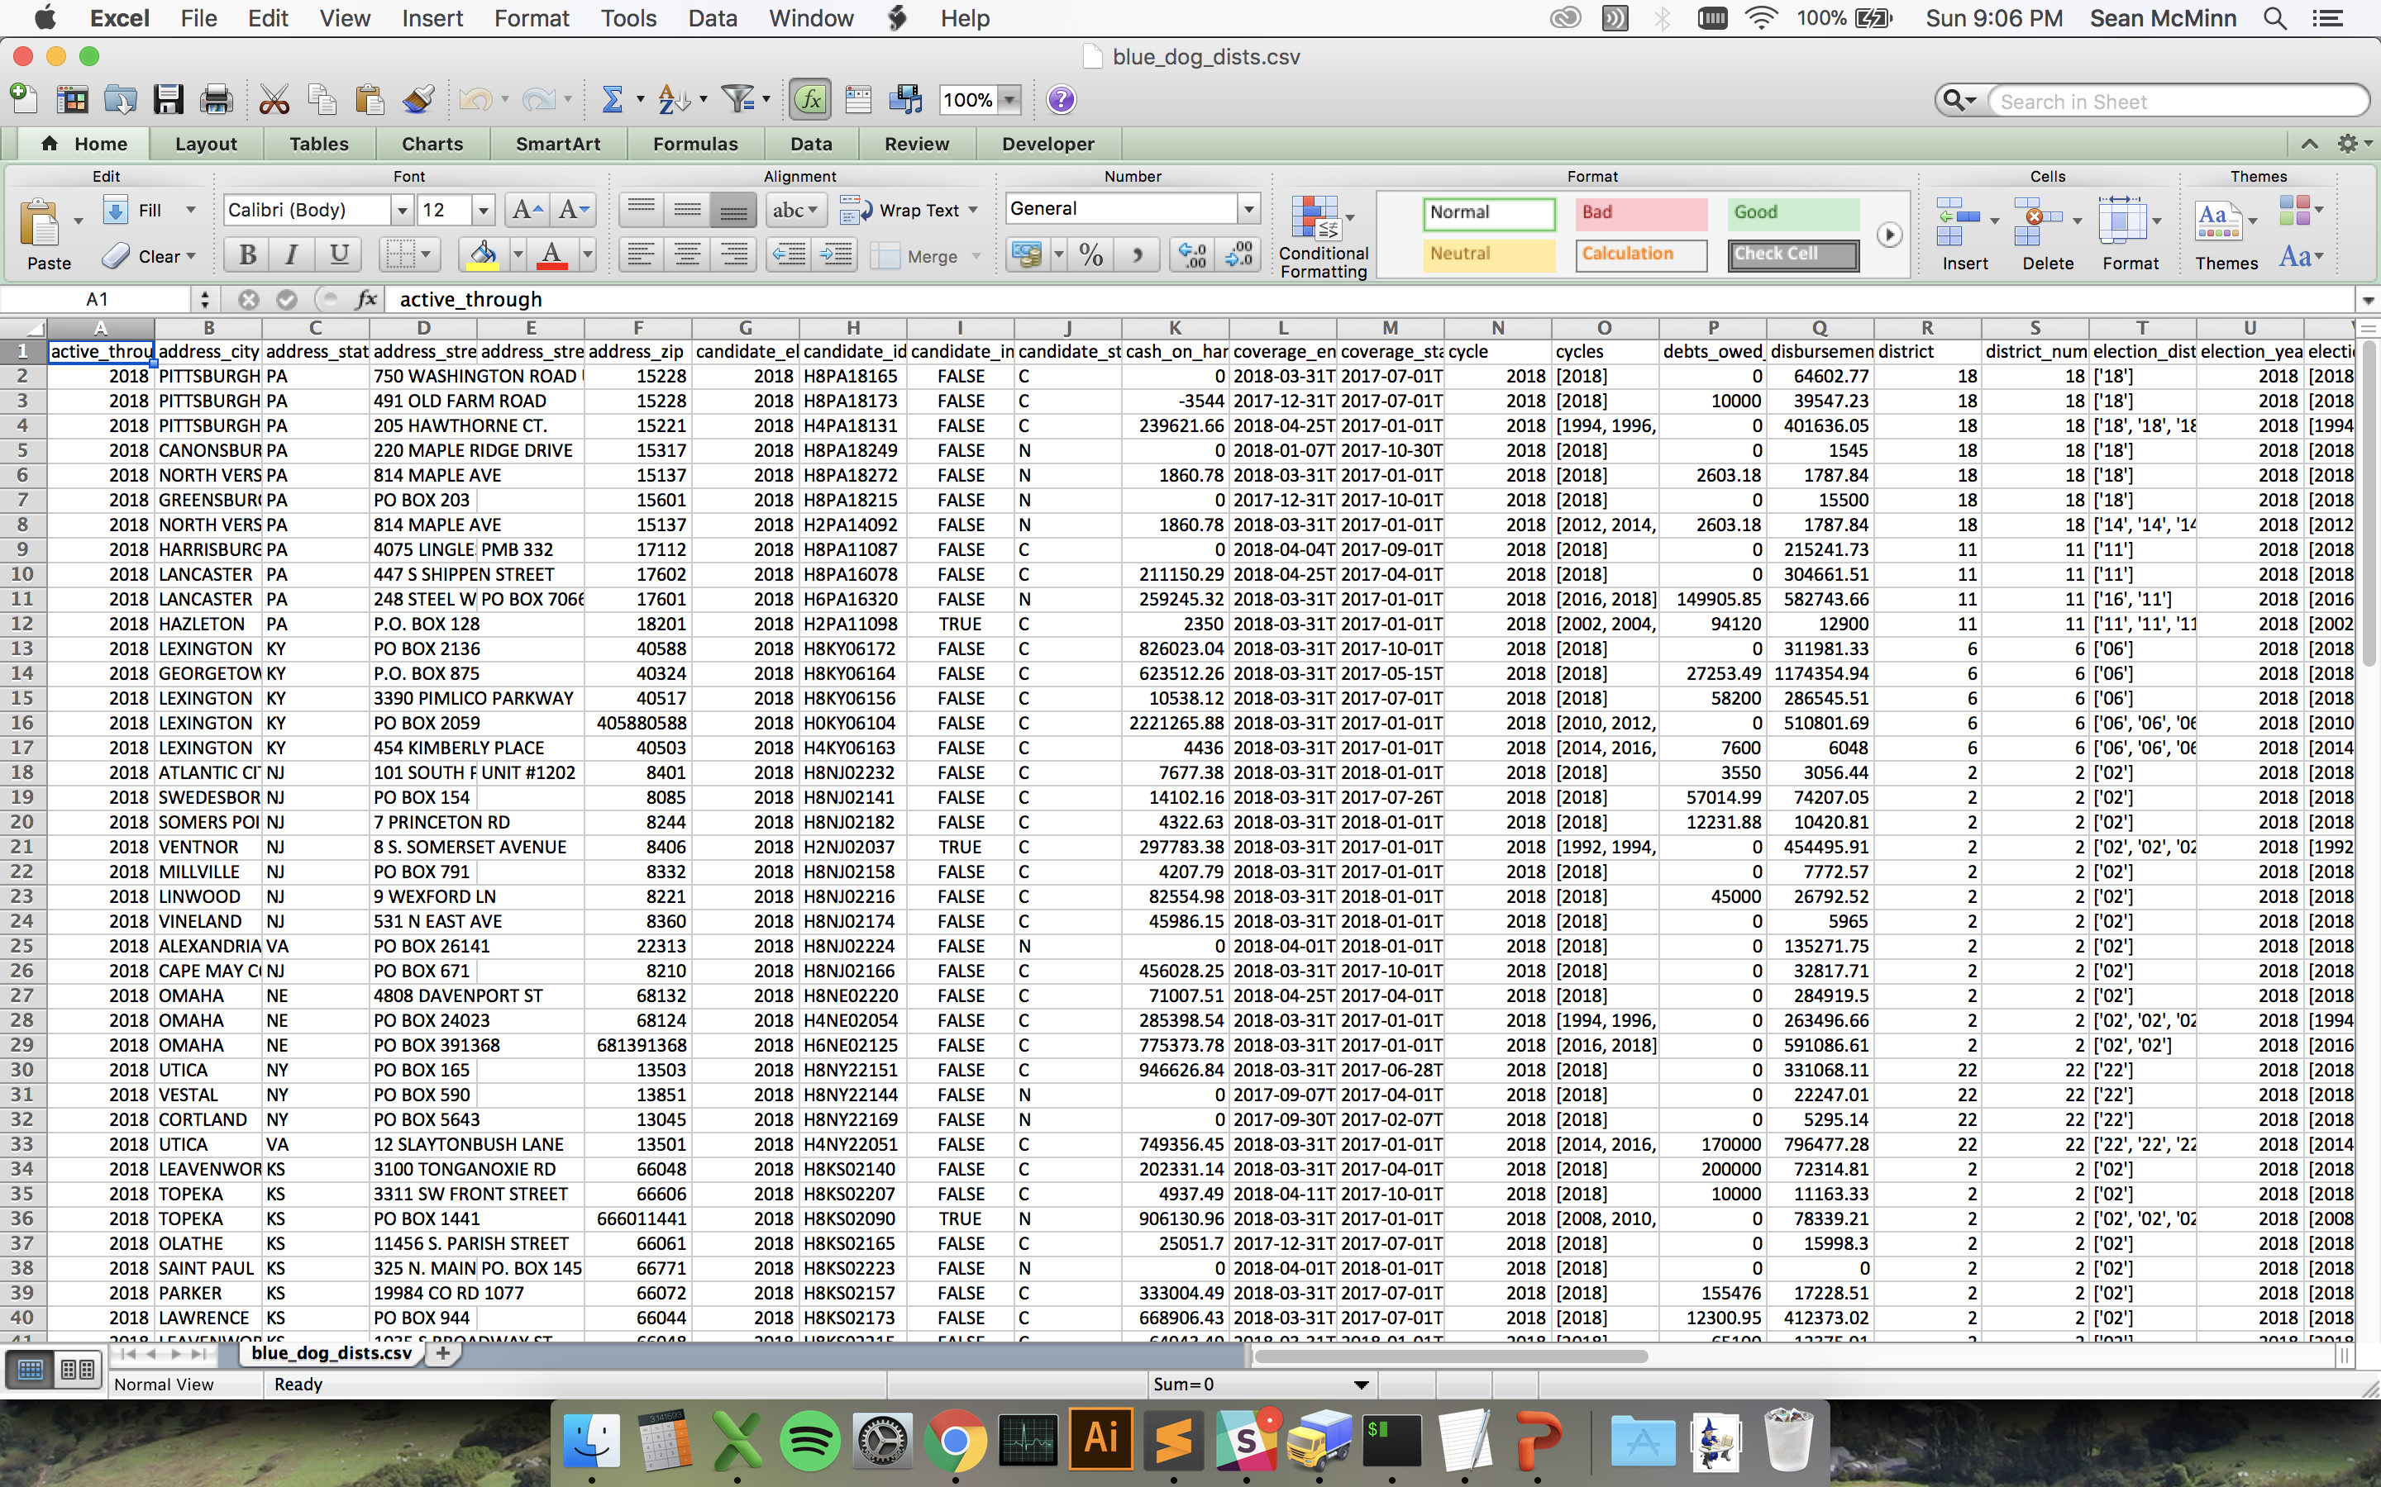
Notes:
20 minutes later, we had a spreadsheet with 3,198 cells filled in. I sent that off to the visual reporter to make a graphic and the reporter to help flesh out his story.

Slide 19
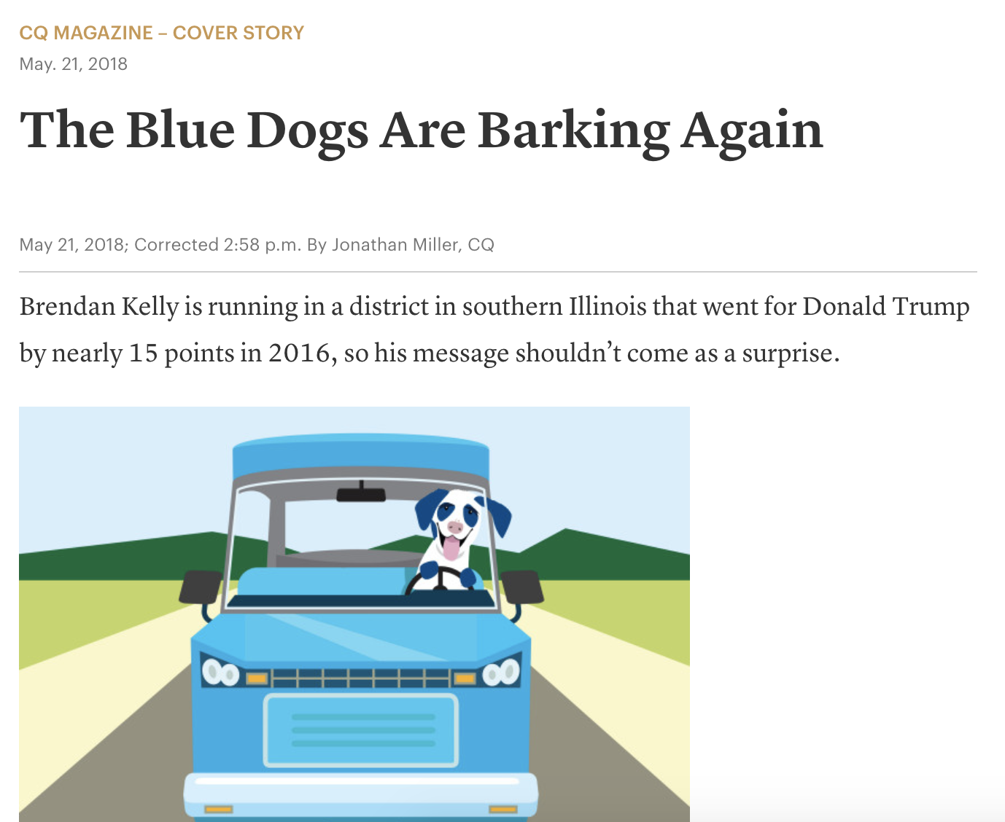
Notes:
The top of this story had no data in it, but the underlying premise – that blue dogs are waging competitive fights – relied heavily on data analysis.

Slide 20
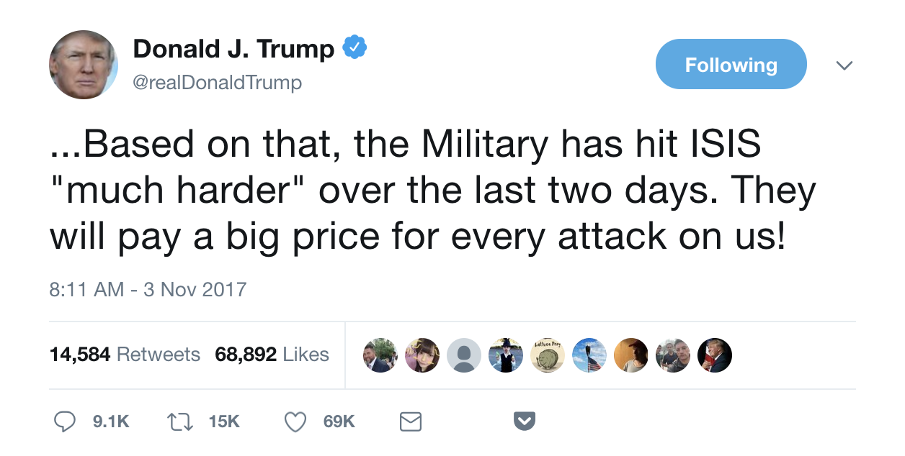
Notes:
Here’s another one. You may remember this tweet from a couple years ago, when the president said we were hitting ISIS “much harder” after an attack in New York City. The president has a tendency to … exagerate .. So we wanted to know if this was true

Slide 21
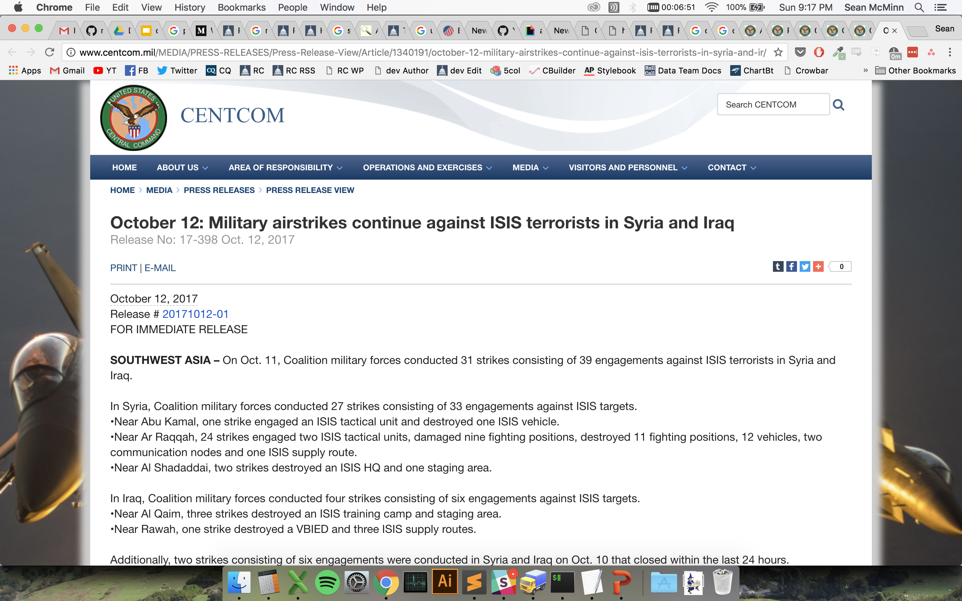

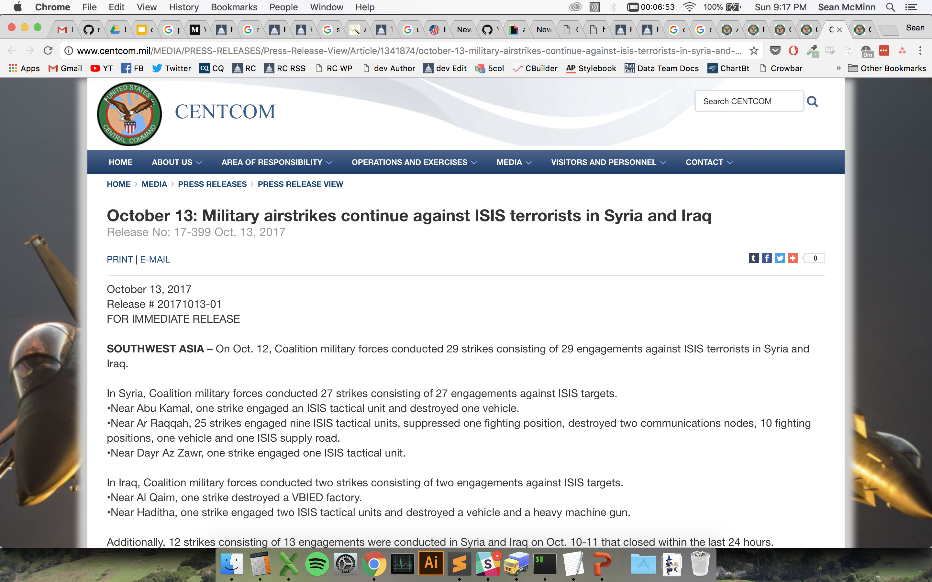
Notes:
As far as I could tell, the Defense Department doesn’t have a database online of strikes against the Islamic State, but it does put out these press releases every day. They’re pretty much just copy paste jobs with the numbers and locations changed, so that seemed like a great project to tackle with web scraping

Slide 22

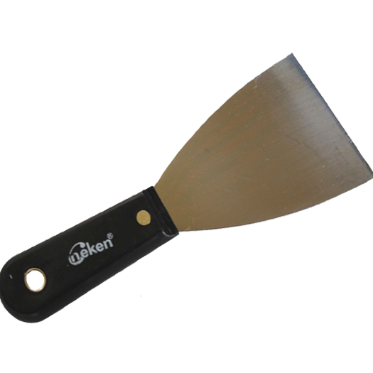

Slide 23
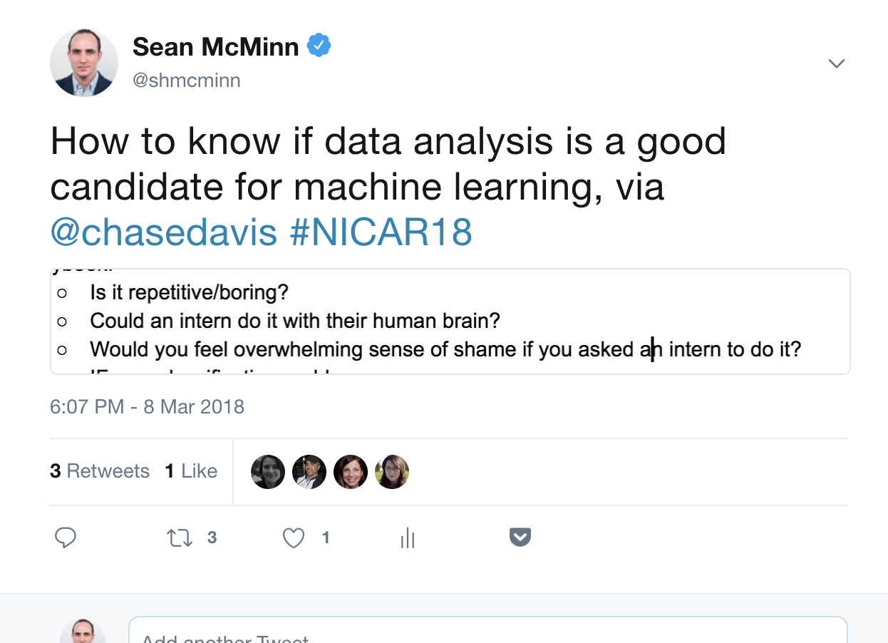
Notes:
I think this applies to web scraping too, even if you’re not using fancy pants machine learning

Slide 24
Notes:
I think this applies to web scraping too, even if you’re not using fancy pants machine learning

Slide 25
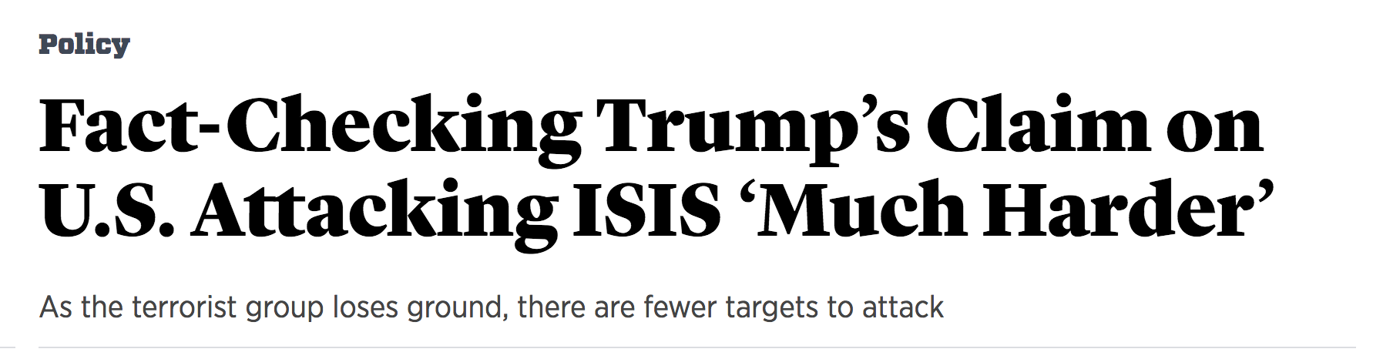
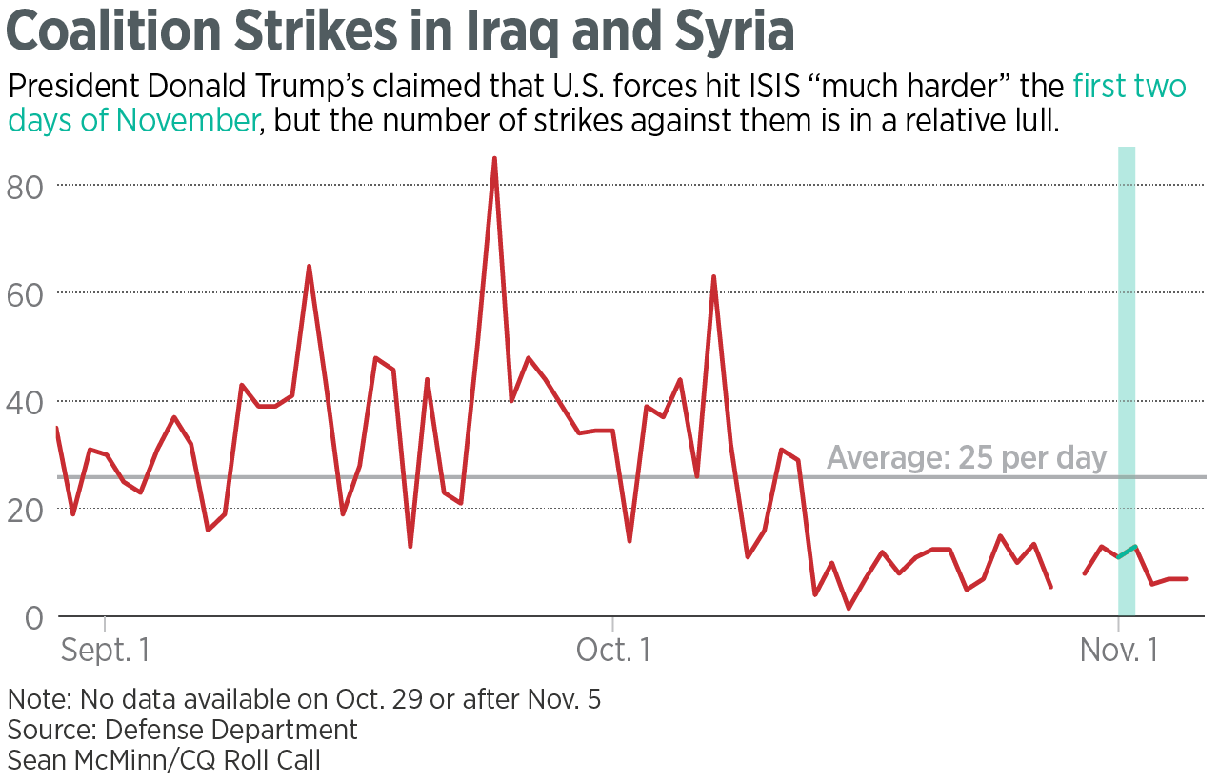
Notes:
So I wrote code that looked for patterns in the press releases, and when it found the text I wanted I had it stick it into a spreadsheet. We ended up publishing this article and making this chart, showing that the president wasn’t being the most truthful.

Slide 26
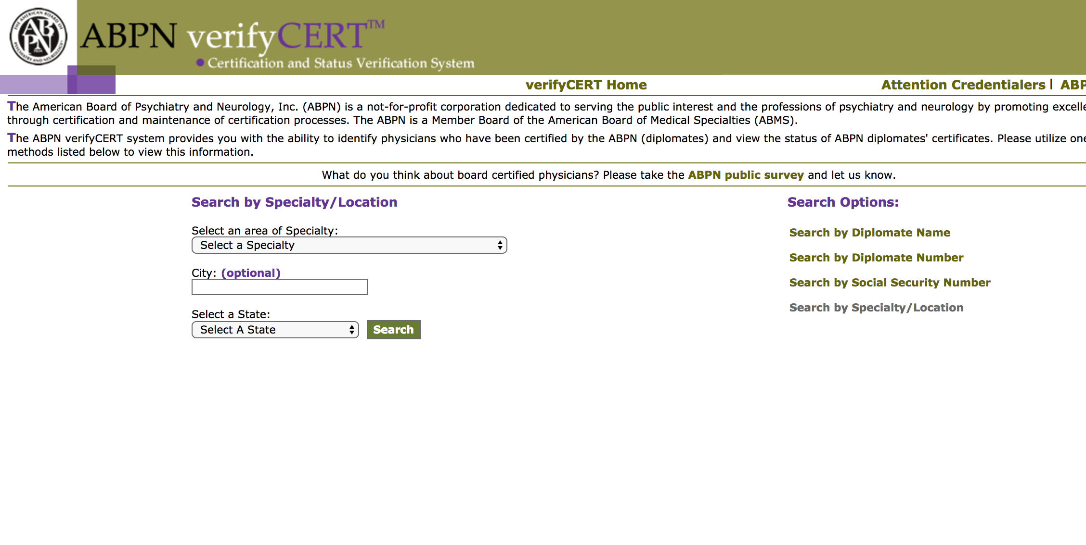
Notes:
Here’s another one. A doctor testified in court, but his name was redacted. But some details were available: his date and place of certification, and some additional biographical information. A reporter discovered that there’s a lookup tool to search for psychiatry and neurology certifications, but you can’t search by date - you can only get lists one specialty and state at a time. He was stuck.

Slide 27
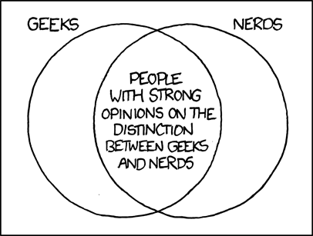
Notes:
Thankfully, this reporter knew the phone numbers of a few friendly local software nerds! This call went to my colleague Jeremy Bowers.

Slide 28
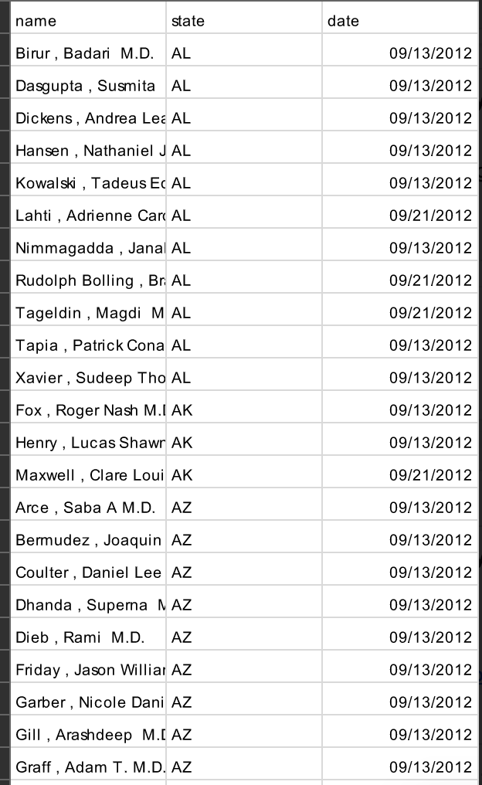
Notes:
The nerds pulled down all the data from the site, including date. So the reporter could sort and search by date, and find the candidates. There were around 900 of them where the date and state both matched.

Slide 29
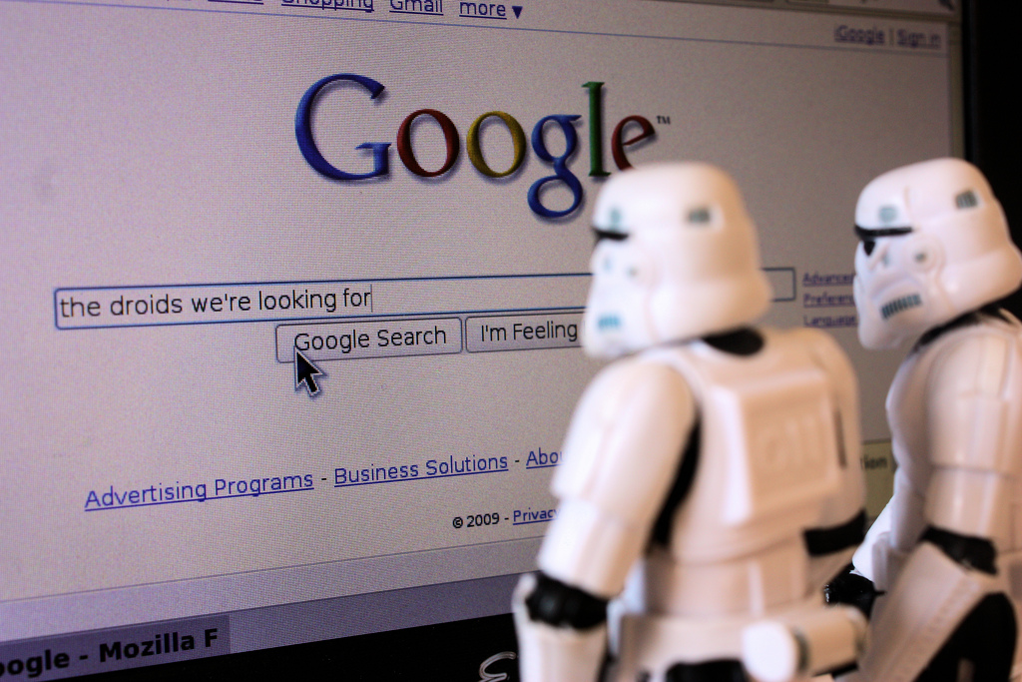
Notes:
Then the reporter turned to google. He made it through 88 before he found one who matched other biographical details in the testimony.

Slide 30
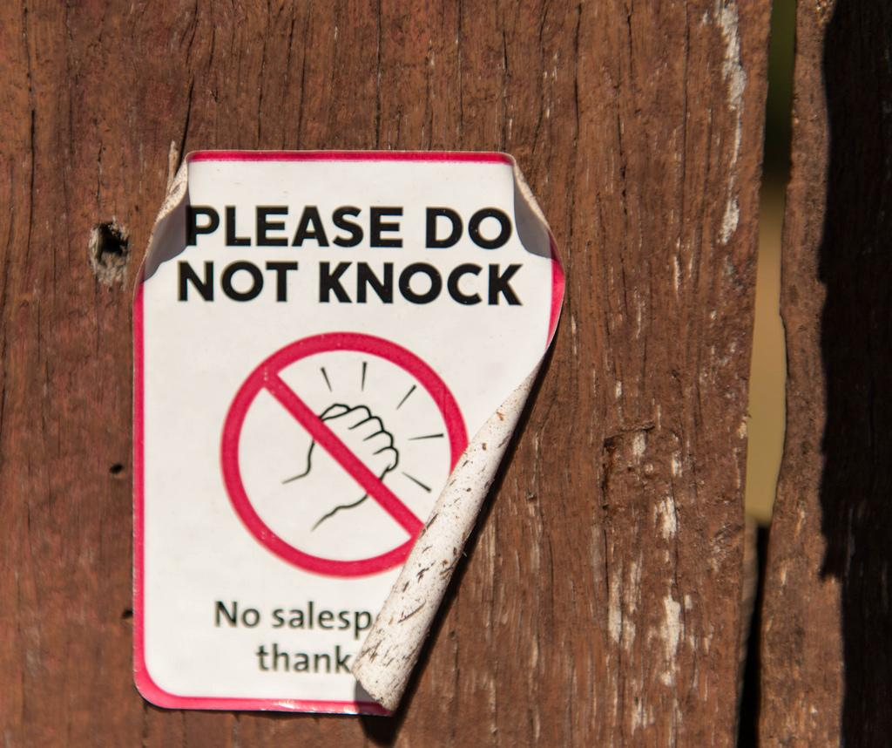
Notes:
Then the reporting team went and knocked on the doctor’s door, and got an hour-long, on the record interview!
This is really a story about something that can only be done with true programmer-reporter collaboration. Not only did the reporter need to recognize this opportunity, he needed to put in the effort to narrow down the 900 person list. But without the assistance from the programmers, there would be no list to narrow.
The match in the end was confirmed by a linkedin page that contained some other professional details listed in the testimony.

Slide 31

https://www.nytimes.com/2016/11/13/world/guantanamo-bay-doctors-abuse.html
Notes:
The interview went on to be part of a five part series on torture at gitmo. This is a case where the data is not an obvious part of the final story. The data component helped the reporters find the story. I love sharing the stories behind stories like this, because this is a true example of how programmers can contribute to the newsroom in nearly invisible but very important ways. There is no quote-unquote data in this article - it’s almost entirely interviews and anecdotes.

Slide 32
The goal of this class is to get you familiar with some tools that will allow you to tell a better story with data….
Notes:
So, what are we really here for?

Slide 33
So you have the tools to feel comfortable if data lands in your lap...
Notes:
specifically

Slide 34
And you are prepared to engage in a conversation about a data and/or technology story...
Notes:
specifically

Slide 35
And you leave this class with an improved BS detector about data/tech stories...
Notes:
specifically

Slide 36
And you’ve created a portfolio piece based on data reporting.
Notes:
specifically

Slide 37
What will classes be like?
We’ll start class with any examples you all saw during the week that are relevant to the kinds of things we’ve been working on. (In general, you are expected to read/watch/absorb the news)

Slide 38
What will classes be like?
Guests! I’ll try to bring some other interesting people working in journalism/data/tech/design.

Slide 39
What will classes be like?
Then we’ll do some lecture, possibly with some discussion, the timing will depend on the week.

Slide 40
What are we covering?
The four steps to completing a data story:
Find data
Clean data
Analyze data
Present data

Slide 41
What are we covering?
STEP 1: Finding data
Open records, FOIA, some underappreciated databases
Notes:
Spreadsheets. Don’t underestimate the power of sum-and-sort journalism.

Slide 42
What are we covering?
STEP 2: Cleaning data
Excel
Common pitfalls

Slide 43
What are we covering?
STEP 3: Stats for journalists
How to sniff out BS and interpret statistics

Slide 44
What are we covering?
STEP 3: Analyzing data
“Interviewing” a dataset
Notes:
Data formats and big data.

Slide 45
What are we covering?
STEP 4: Data visualization
How to make charts suck less
Easy/free tools
Notes:
Data formats and big data.

Slide 46
What are we covering?
STEP 4: Presenting/storytelling with data
Learn some Tableau
Look at different story forms
Notes:
Data formats and big data.

Slide 47
What are we covering?
BONUS: Covering government with data
Lobbying
Campaign finance
Congress and federal agencies
Notes:
Data formats and big data.

Slide 48
What are we covering?
BONUS: What the Hell is an API? (and other questions I was too afraid to ask) — plus project interviews
The industry standard tools data reporters to use to do their jobs
Notes:
Data formats and big data.

Slide 49
What are we covering?
BONUS: Other things smart people know more about than I do
Panel of working data journalists
Notes:
Data formats and big data.

Slide 50
Assessment quiz
To see where we’re at, and to get a benchmark for end-of-quarter improvement
github.com/shmcminn/digitalframeworks-spring19
OR
bit.ly/2JRTgEG

Slide 51
Final Project
You’re responsible for writing a 1,000-word data story by the end of the quarter.
More info in finalproject.md file on github

Slide 52
Policies
Consuming the news
You are expected to find at least one story (written, video, graphic, whatever) each week that uses data or technology in an integral way. Please come to class with a link ready to go, I will ask a few students at random to share a story they found. This will contribute to your participation grade.

Slide 53
Policies
Grading:
Participation/attendance: 20%
In class assignments (becomes homework if you don’t finish): 50%
Final project: 30%
(this is all on the syllabus)
Notes:
To be totally clear about this: I know you need to get at least a B in this class for it to count. Let’s talk about the ways to get there:
*you could never show up in class (except to present your final project), but you’d have to be 100% perfect on your assignments
*I plan to assign 7 assignments, You could fail to turn in 3, hope I’m inclined to round up, and be perfect on everything else.
*You could do a miserable (but not zero) job on your final project and be perfect on everything else
PLEASE DO NOT DO ANY OF THESE. I really don’t want to give you a grade that will get in the way of your graduation. I know you are busy with internships, so the workload in this class is designed to be reasonable. If you show up to class, turn in your assignments on time and put some effort into your final project, you’ll get the grade you need easily, it won’t overwhelm you, and you’ll learn some valuable skills.

Slide 54
Policies
Grading:
Late assignments will NOT be accepted unless we come to an agreement BEFORE the assignment deadline. This is how newsrooms work.
I am aware you need to get at least a B- for this class to count toward your degree. If you miss more than 3 homework assignments, it’s impossible to get a B-, even if you get 100% on everything else. Please do not do this.
Notes:
I will do everything in my power to help you pass this class with at least a B-, but I can’t make up assignments you didn’t turn in.

Slide 55
Policies
Grading scale for assignments:
A: publishable with minimal edits
B: publishable with significant edits
C: would need reporter’s revision to be published
You can not get more than a C on an assignment if there are factual errors
D: unpublishable, even with edits
F: did not complete assignment
Notes:
I will do everything in my power to help you pass this class with at least a B-, but I can’t make up assignments you didn’t turn in.

Slide 56
Policies
Unless otherwise noted, assignments should be written in sentences and paragraphs (not bulletpoints, fragments, etc)

Slide 57
Policies
Submitting assignments:
Assignments must be submitted on Github. We’ll go into details about how and why later in this lecture. Working on Github is an important skill I want you to leave this class with, so I will not accept homework submitted any other way.

Slide 58
Policies
Collaboration:
Students are encouraged to discuss assignments. For the most part, you will be working on different things, so talking about your work should not be a problem. Whiteboarding your way through a sticky problem with a friend or looking online for answers to technical questions are encouraged (programmers do that all the time!) Your final work, however, must be entirely your own. A good rule of thumb is that no one else should take over your keyboard while completing an assignment. Ask if you are unsure.

Slide 59

Github
Notes:
For the remainder of this lecture, we’ll be talking about github. It’s where you’ll submit your homework, and where your final project will go.

Slide 60
Github
I often hear people say that github is easy. These people fall into one of three categories:
People who only know about a very small number of features
Developers at Github
Liars
Notes:
I tell you this not to intimidate you. We’re mostly going to be in category 1 here. I’m telling you this because I don’t want groups 2 and 3 to intimidate you away from using it and asking questions. Github is important to understand for reasons we’re about to discuss, and it is important that you know that it is hard for people who have been using it for years, so you should not feel stupid or intimidated if you get stuck. Everyone started from scratch once, and if anyone is nasty to you about it, they’re a lying asshole.

Slide 61
Github: What is it
Collaborative
Distributed
Version control

Slide 62
Github: Collaborative
A team of people can work on the same project together. If the project is open-source, anyone can contribute (but there are protections)

Slide 63
Github: Distributed
We can work at the same time on the same thing, and resolve conflicts later. We can even maintain multiple versions of the same code or document. You can easily work while offline.
Notes:
Have you ever been in google docs and seen other people add and delete stuff above you and things jump around? Yeah, Github prevents that.

Slide 64
Github: Version Control
You get to plant flags (called commits) and it saves a copy at that point. So you never have to title a file story_final_v3_REALFINAL.docx again.
Notes:
Examples of version control are microsoft or google docs’ Track Changes features.

Slide 65
Github: bonus
Your stuff is stored in the cloud so it also works as a backup.

Slide 66
Github: why so hard?
Remember that part about both of us working on the same thing at the same time? What happens when we have to reconcile that?
Github is super smart and does it for you!
Sometimes.
We mostly won’t be talking about this today.

Slide 67
Github: then why are we doing it?
So you can use it if that’s what your collaborators are using it (it is the standard in most data/tech orgs)
You might very well find it incredibly useful
It is a portfolio with a certain kind of currency
My team at NPR asks intern candidates for a link to github profile

Slide 68
Git/Github: General idea
You can work on your computer, keep track of all your changes and sync your work with github account. We’ll get set up to do that in the next few steps.

Slide 69
Github: Make an account!
Go ahead and make an account if you haven’t before.
https://github.com/
Protip: github becomes a portfolio for a lot of people. As such, you might want to use a somewhat professional username.

Slide 70
Github: Create a new repository
Log into github. In the top right corner, click the plus sign, and go to “new repository”. This one will be where you submit your homework. Please call it digitalframeworks-spring2019 (so I can find it easily)
Notes:
A repository is like a folder. See next slide for details

Slide 71
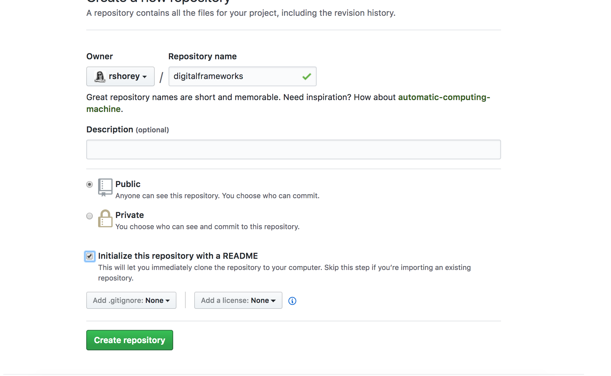
Github: Create a new repository
Call your repository digitalframeworks-spring19
Make it public
Check this box
Notes:
A repository is like a folder. That’s what it’ll look like on your computer.

Slide 72
BUT WAIT
I need to know where to find your repo!
Please fill this out
https://forms.gle/FQRKaHskGckggpjN7
OR
https://bit.ly/2Ww9Vis

Slide 73
Markup languages
We’ll be writing our assignments in Markdown.
Markdown is a markup language
Anyone familiar with other markup languages?
Notes:
HTML, XML, LaTeX
HTML: Hypertext markup language
XML: Extensible markup language

Slide 74
Markup languages
“A markup language is a system for annotating a document in a way that is syntactically distinguishable from the text.” --wikipedia

Slide 75
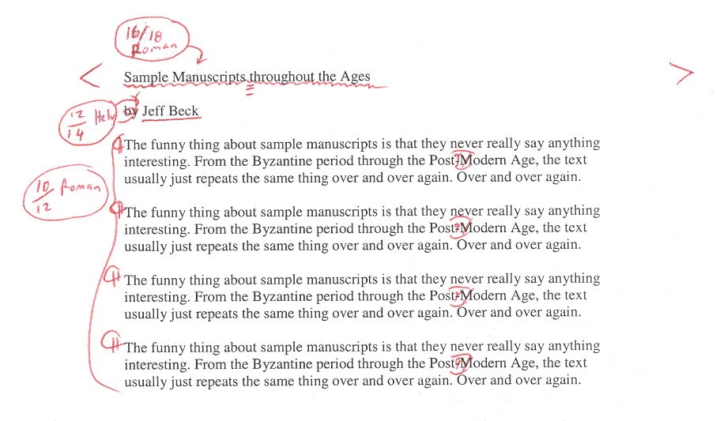
Markup languages
Notes:
Markup languages actually have a nice journalism history. The idea is to do digitally what writers and editors used to do with a red pen

Slide 76
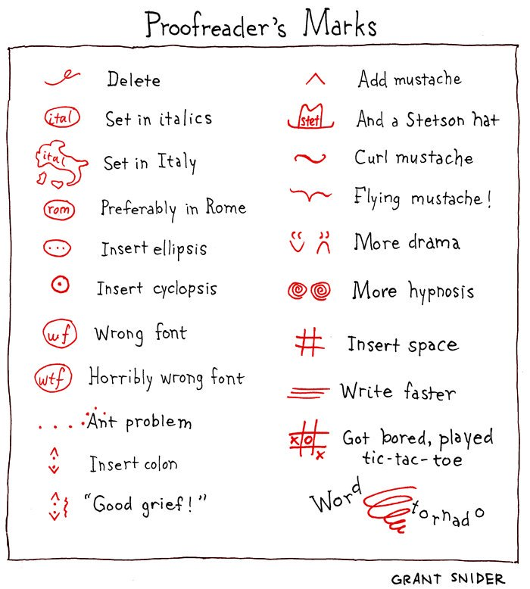
Markup languages

Slide 77
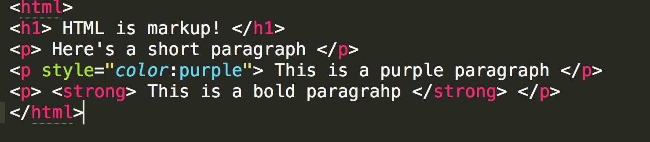
An HTML example
Notes:
You’re likely at least slightly familiar with HTML

Slide 78
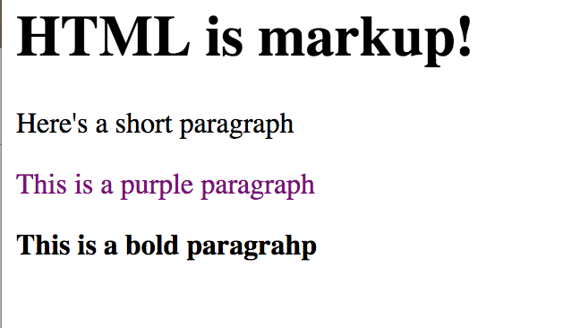
Notes:
And this is what it looks like on the web. The tags (which are the markup part) dictate things like size, emphasis, color, spacing…

Slide 79
So why not just use HTML?
We’re using Markdown because:
It is easy to read and write
If you ever work on a data or tech project, even as a non-tech person, it’s likely what instructions/documentation are written in

Slide 80
Fundamentals of Markdown
Headers look like this:
# h1 (the biggest)
## h2
### h3 ...

Slide 81
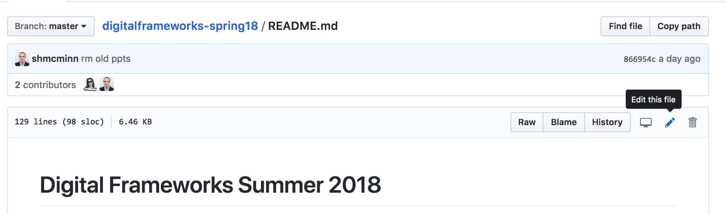
Write your README

Slide 82
Write your README
# Digital frameworks – Summer 2018
### By Sean McMinn
Some description you want to write to tell people what your repository is

Slide 83
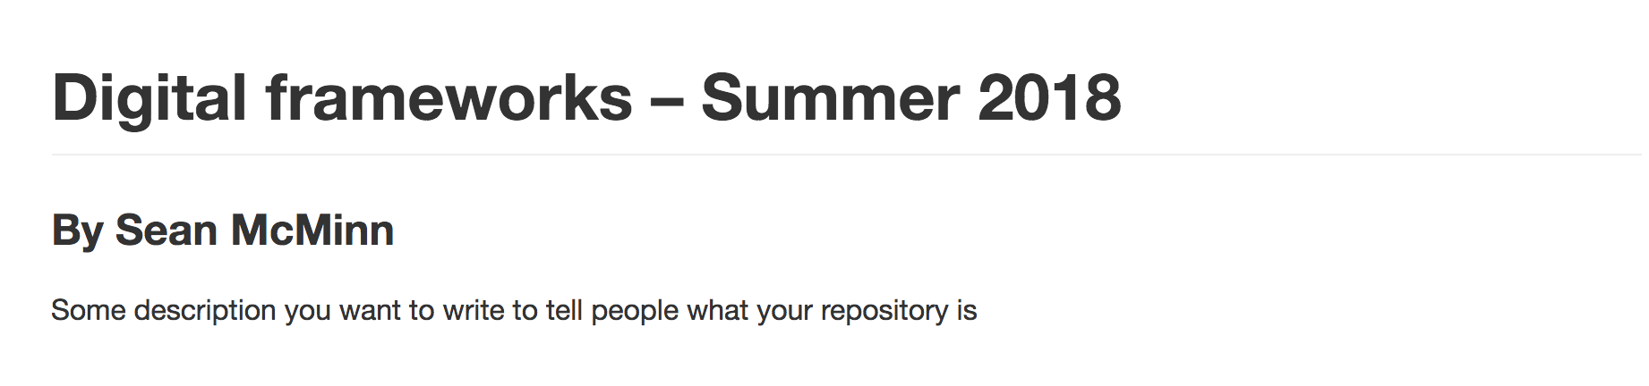
Write your README

Slide 84
Fundamentals of Markdown
Emphasis
*this text is italic*
_this text is ALSO italic_

Slide 85
Fundamentals of Markdown
Emphasis
**this text is bold**
__this text is also bold__

Slide 86
Fundamentals of Markdown
Emphasis
*this text is italic __but this part is also bold__!*
**this text is bold _but this part is also italic_!**
Notes:
Why both the stars and the underbars for italic and bold? It makes it easy to combine them!

Slide 87
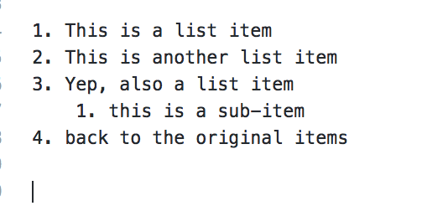
Fundamentals of Markdown
Lists (ordered)
Notes:
Ordered lists have numbers (or letters or whatever), unordered lists are like bullet points.

Slide 88
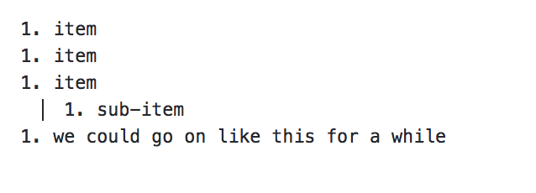
Fundamentals of Markdown
Lists (ordered)
Notes:
Have you ever made a list, and realized you have to go back and add an item at like #3 and then have to re-number the whole thing? Markdown knows about that bad problem, so you actually don’t need to number your list. You can just use 1. For every item and it numbers them automagically.
(note that to get the sub-item to work, you need 4 spaces)

Slide 89
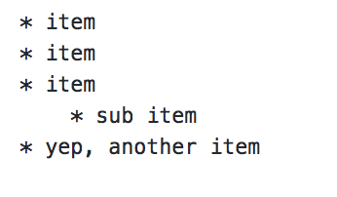
Fundamentals of Markdown
Lists (unordered)
Notes:
This is going to look familiar

Slide 90
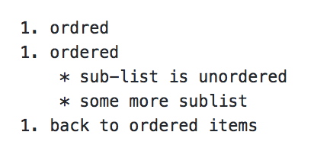
Fundamentals of Markdown
Lists (you can combine ordered and unordered)

Slide 91
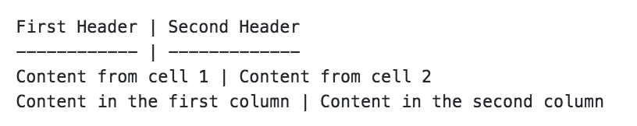
Fundamentals of Markdown
Tables
Notes:
You basically make a thing that looks like a table with pipes and hyphens. You don’t have to be precise about spacing or anything, it figures it out and makes you a nice little table!

Slide 92
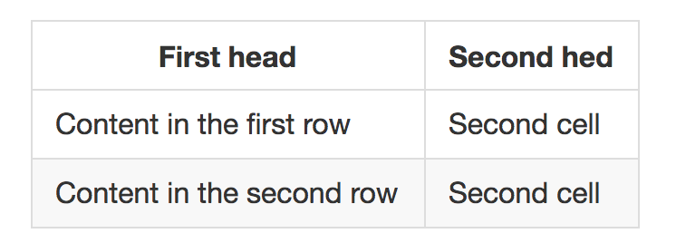
Fundamentals of Markdown
Notes:
You basically make a thing that looks like a table with pipes and underscores. You don’t have to be precise about spacing or anything, it figures it out and makes you a nice little table!

Slide 93
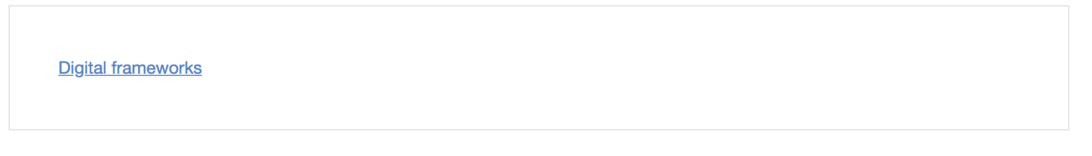
Fundamentals of Markdown
Links
[text](url)
For example:

Slide 94
Markdown and homework
You’ll be submitting your in-class assignments as a markdown file on github with the title assignment1.md (or assignment2.md, etc).

Slide 95
Markdown and homework
For this week, you’ll come up with two final project ideas, and complete our first data reporting critiques on a published data story related to each topic.

Slide 96
Markdown and homework
Objective: Clarity and accuracy
Were you able to immediately identify the central insight the reporter was trying to communicate? Answer on a 1-5 scale, with 5 being excellent and 1 being below expectations.
What was it?
Was it in the headline?
Were you able to quickly understand how you would navigate the data? Again, use a 5- point scale with 5 = excellent
Was that the most efficient way to navigate?
Can you suggest ways to improve navigation?
Using your own knowledge and critical thinking abilities, do you think the data was accurate? 1-5, with 5 most accurate
List any areas where you question the accuracy of the data.
List sources you would suggest the reporter check with.
Did they provide a source?
Did they explain everything that needed explaining?

Slide 97
Markdown and homework
Objective: Quality
Regardless of the form that the graphic/story takes, was it executed at a high degree of quality? (Rank 1-5, with five excellent.)
Explain what they did well and areas where improvements could be made.
Consider some tasks a data story must do well: (present, compare, organize, correlate)
Did this graphic accomplish all tasks?
If not, which ones did it not accomplish

Slide 98
Markdown and homework
Objective: Type and color (if piece includes graphics)
Based on your knowledge of color and type use, did this person use type (as in typography, fonts) and color to their best purpose?
For example, did it:
Look like it all belonged together?
Draw your eye first to the most important pieces of information?
Make sense? For example, if it discussed heat, did it use the color red to communicate the degree of heat rather than, say, blue?
Type (1-5)
Explain
Color (1-5)
Explain

Slide 99
Markdown and homework
Objective: Creativity
Did the piece use some creative elements to good effect? As in, to emphasize those areas that could draw someone in, or to add detail where needed, but not just random visual or story junk that distracts you?
How?
Rate effectiveness on scale of 1-5.

Slide 100
First steps:
Create and commit a file

Slide 101
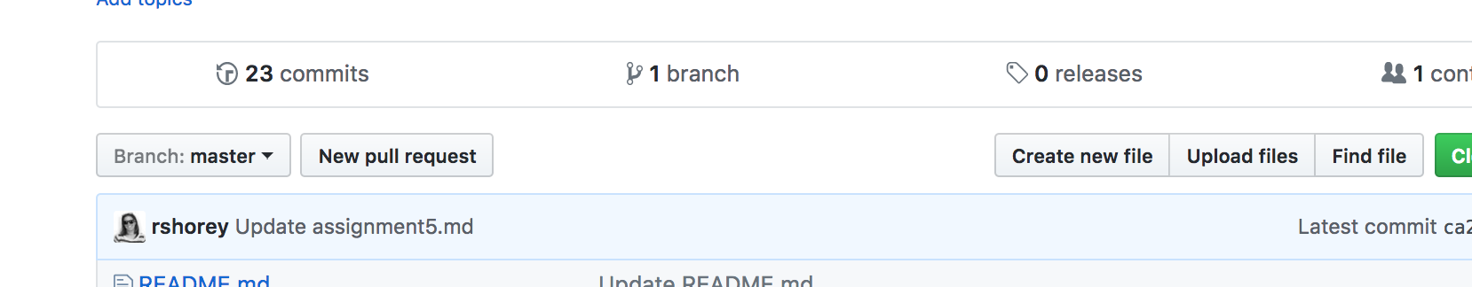
First steps:

Slide 102
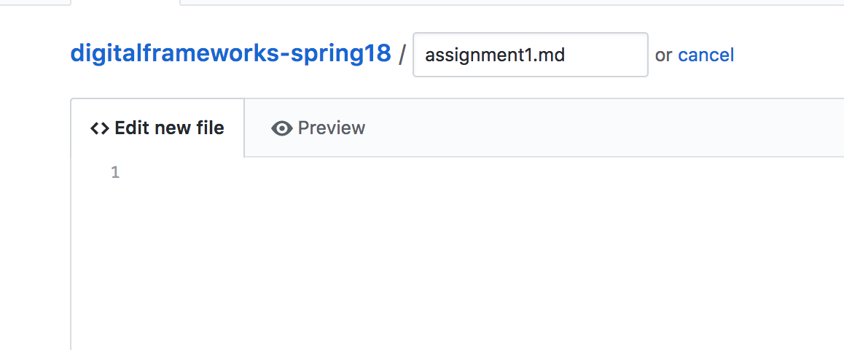
First steps:

Slide 103
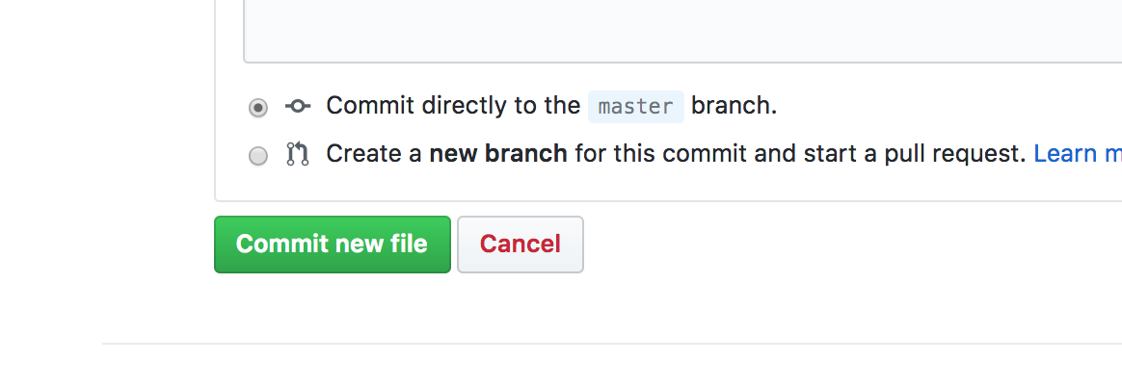
First steps:

Slide 104
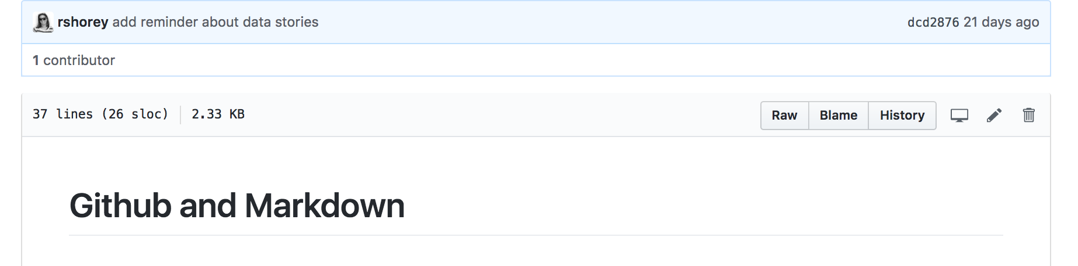
Once you’ve committed, you can edit again. First click the file (if you’re on the main page). Then click the edit button.
Notes:
Don’t forget to commit after every edit

